Slide 1

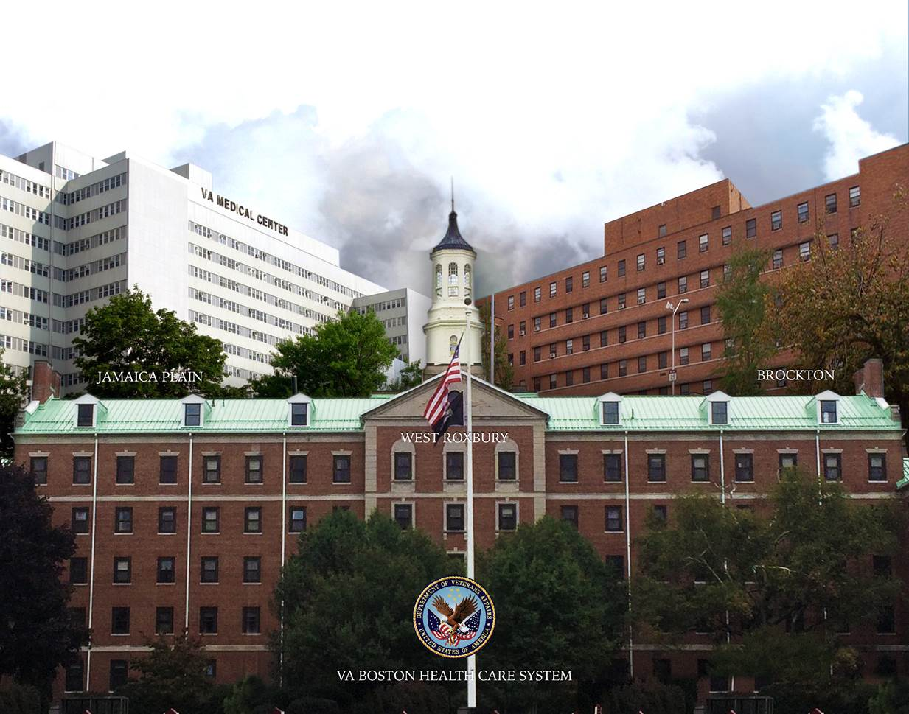


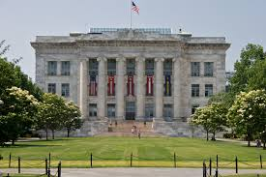
The Million Veteran Program: A Modern Mega-Cohort within a Healthcare system
Using Big Health Data to Improve Health Care
J. Michael Gaziano, MD, MPH
Scientific Director, MAVERIC and PI, MVP, VA Boston Healthcare System
Chief, Division of Aging, Brigham and Women’s Hospital
Professor of Medicine, Harvard Medical School

Slide 2

MVP: A New Type of Cohort Study
History of data use in population science
The use of passively collected big health data in health science
VA as a player in big health data: MVP and a pragmatic trial
Data challenges
VA-DOE collaboration in health data science

Slide 3
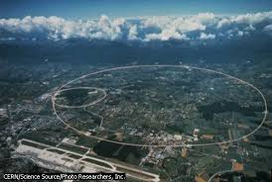

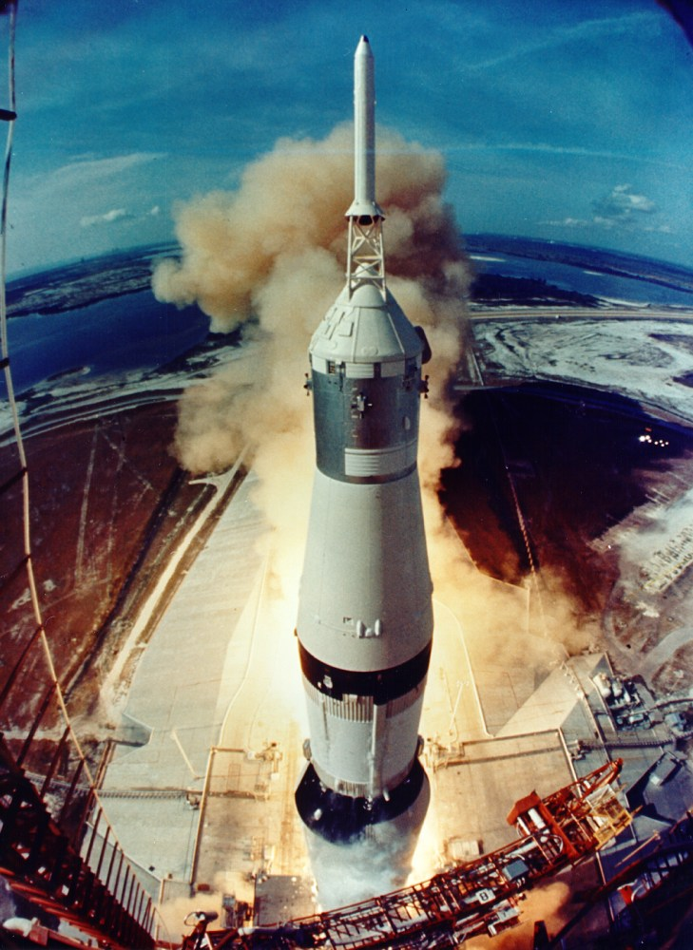





Transformative “Data” Problems in Science

Slide 4



The Promise
  The promise of new epi technology using big health data: To improve health, prevent and treat disease by empowering providers, patients and health systems with better access to and use of health data.
Yesterday
Today
Tomorrow
Data
Signs/Symptoms-based
Pattern-based
Algorithm-aided
Actions
Intuition-based Medicine
Evidence-based Medicine
Precision-Medicine

Slide 5
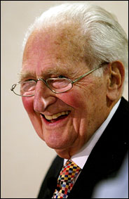

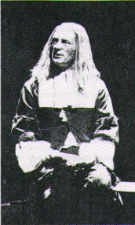
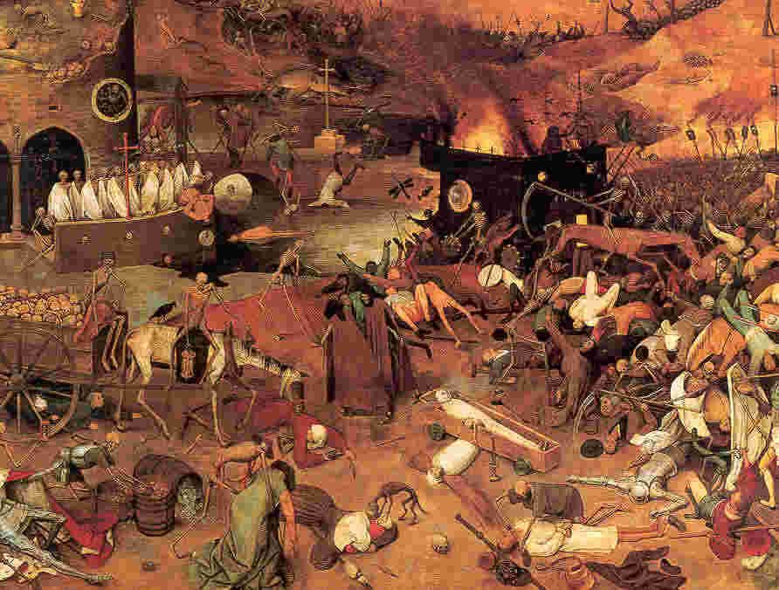
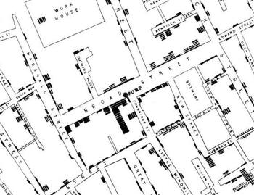
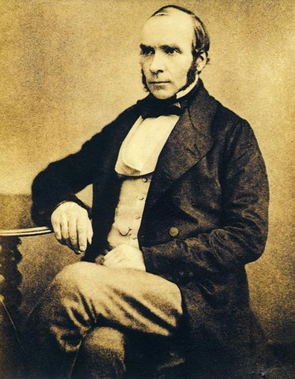
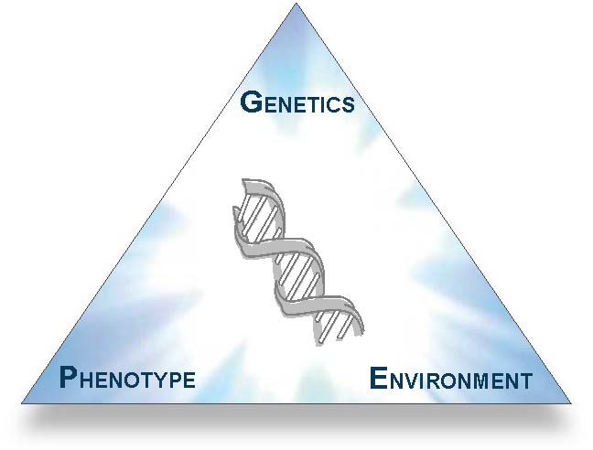
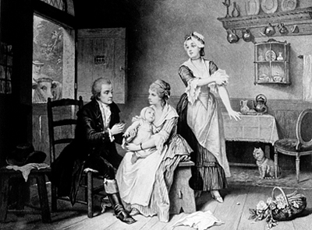
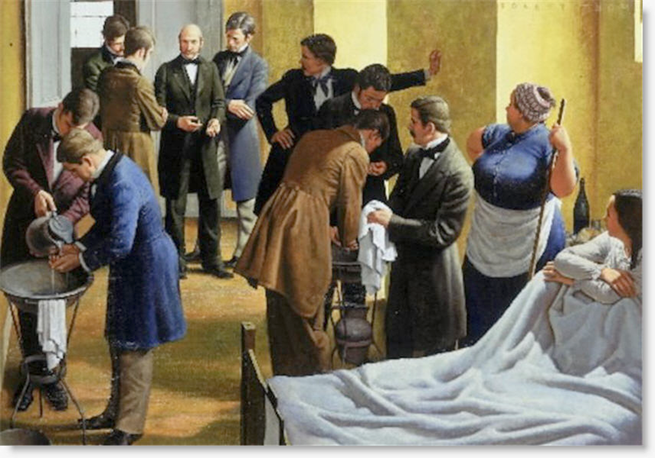
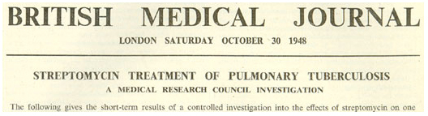
Evolution of Data in Epidemiology
Descriptive phase
Pre-analytic phase
Analytic phase
  Case-control, Cohort studies, RCTs
Super Analytic Phase:
  Mega-Biobanks
  Omics
  Big data analtyics
The Black Death
 | Disease | No Disease
Smoking | 8 | 2
No Smoking | 2 | 8
“Death in old age is inevitable but
death before old age is not.”—Richard Doll
Bruegel’s
Triumph of Death
c. 1556

Slide 6





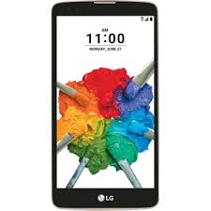

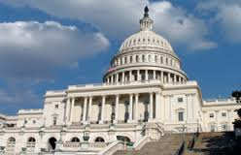




Financial Services
Healthcare
Education
Energy
Who Uses Big Data?
Entertainment
Communications
Retail
Government
Manufacturing
Transportation
Natural Resources
Insurance

Slide 7
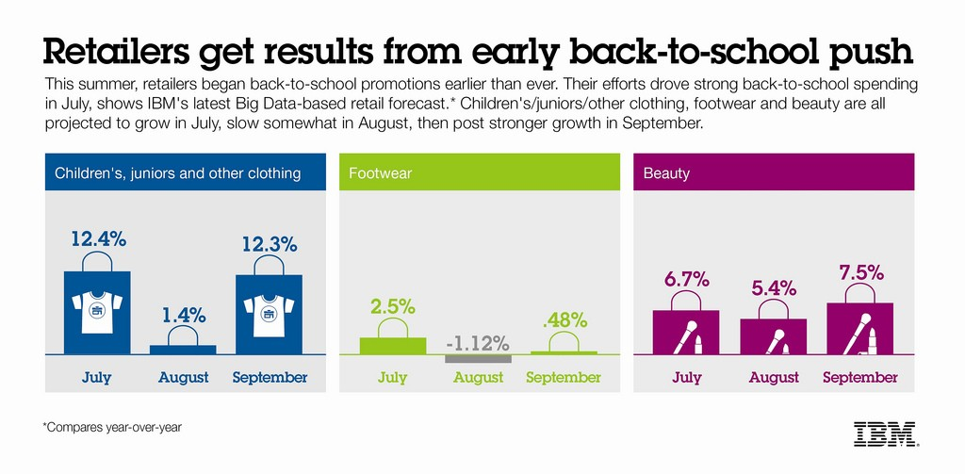
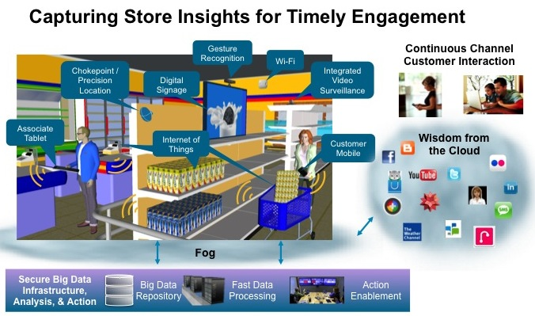

Example:
Retail

Slide 8


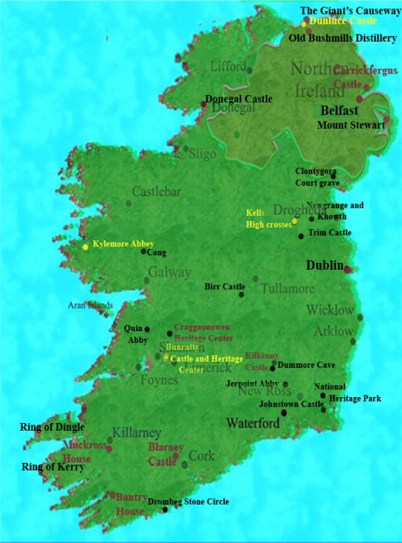



Example:
Credit card companies
Call to collect info about transaction – within 30 seconds
Questions:
Do you have your card? yes
Are you in Ireland buying gas at….? yes
Would you like to keep your card active? yes

Slide 9
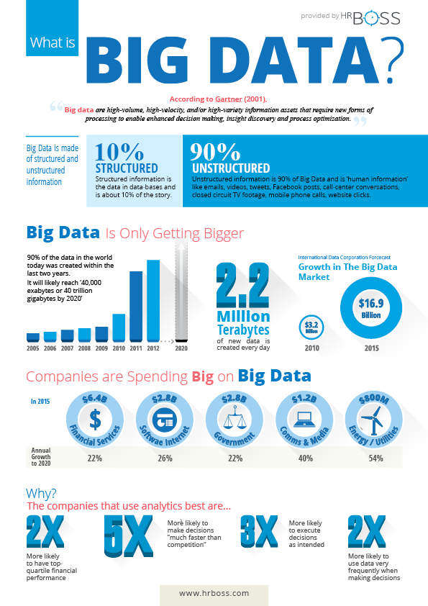
What is Big Data?
Information with high volume, high velocity and/or high variety that requires new forms of processing to allow enhanced knowledge generation, decision making and process optimization.

Slide 10

John Graunt

Slide 11


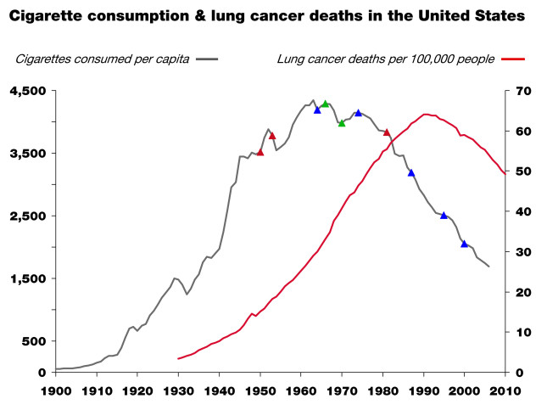

Who first figured out that smoking took years off your life?

Slide 12
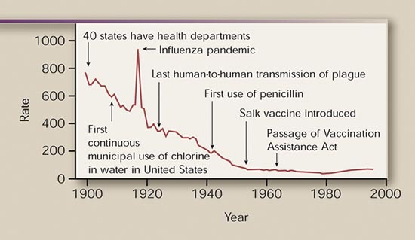
Decline in Mortality due to Infectious Disease, United States, 1900-1996
What caused this peak?
MMWR 1999; 48:621-629

Slide 13
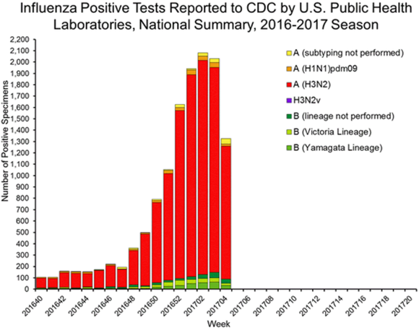
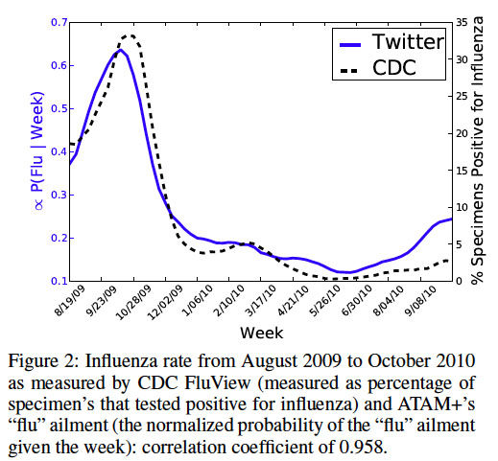
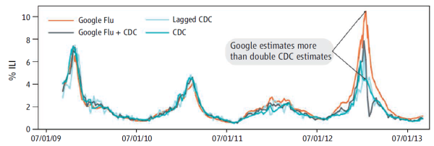
Example:
Use of Big Data to Predict Flu in real time
Twitter
Google

Slide 14
Three revolutions are making it possible to apply big data solutions to health care
Biotechnology
Electronic Health data
Computing

Slide 15



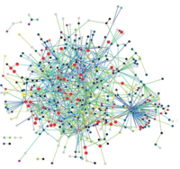
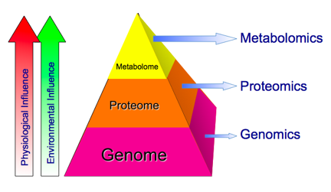

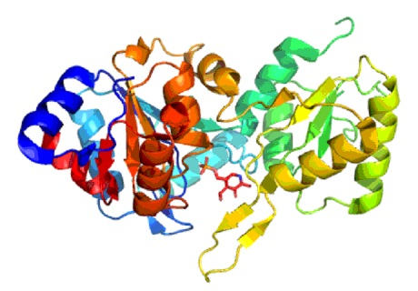
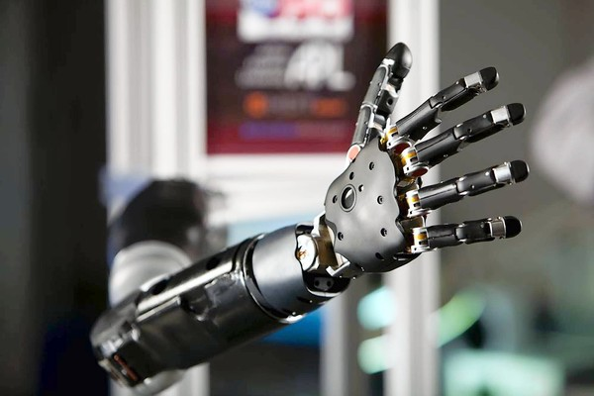
Sequencing
“OMICS”
Genotype
Imaging
Proteomics
Robotics
Metabolomics

Slide 16

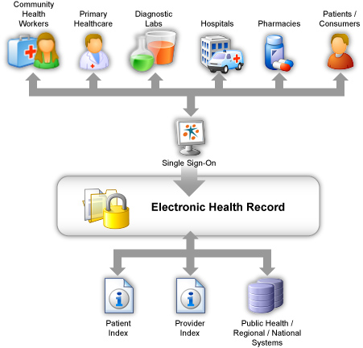
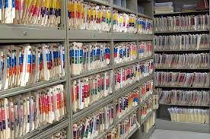


Slide 17
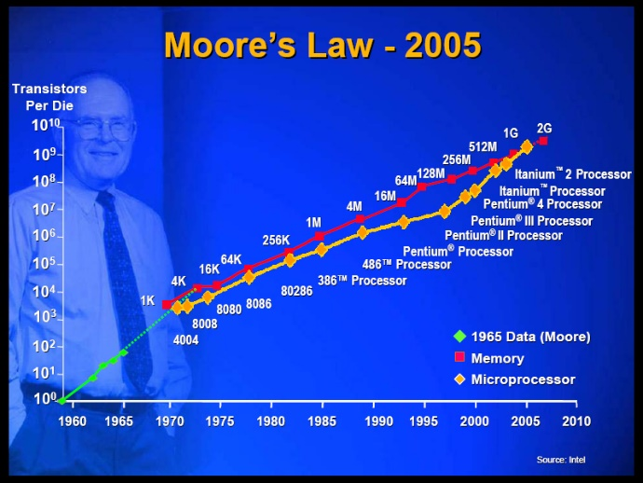




Computing

Slide 18
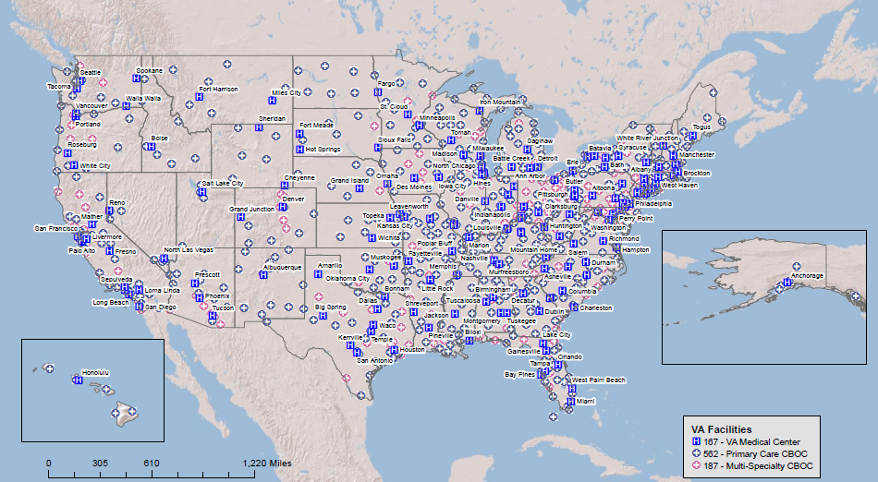
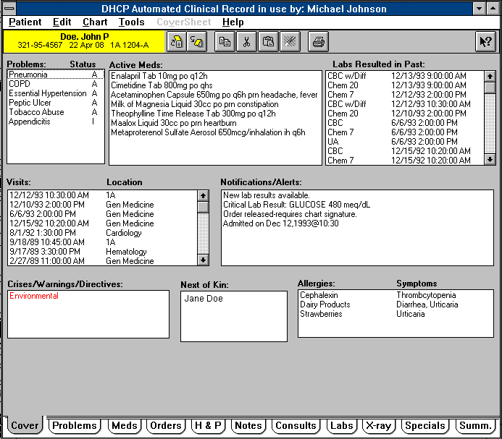
Data Science in the VA
VA Healthcare System is the ideal setting for state-of-the-art Pop Science:
  Outstanding electronic medical record; access to other data (CMS, DOD, NDI data, etc.)
  Research infrastructure in basic, clinical an health services research
  Stable and willing veteran population
  Ongoing uses of VA data:
    Observational studies and mega-cohorts such as the MVP
    Pragmatic trials
    State-of-the-art basic, clinical, rehab and health services research
    Quality improvement
    Clinical care: precision oncology

Slide 19
VA Big Data Needs
Research optimization
  Curation and manipulation of clinical data
  Handling Imaging data
  Innovation: pragmatic trials
  MVP: genetics and other omics
Clinical care
  Clinical analytics
  Provider assistance
  Patient empowerment
Health system management
  System analytics
  Quality improvement
Benefits

Slide 20

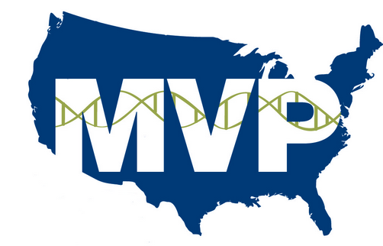
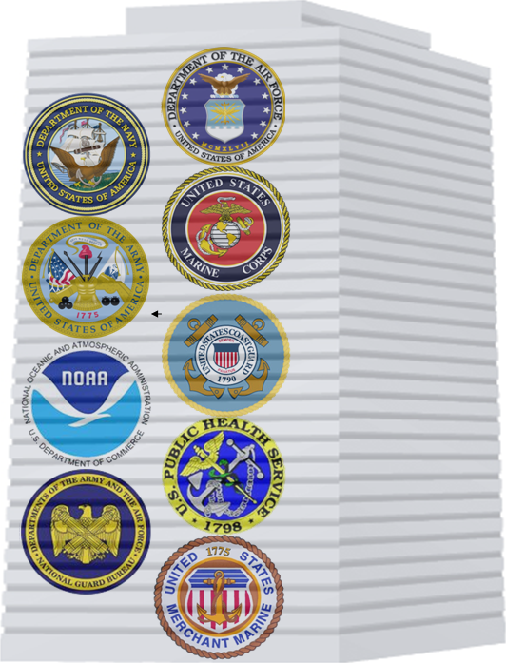
Enroll up to one million users of the VHA into an observational mega-cohort
  Collect health and lifestyle information
  Blood collection for storage in biorepository
  Access to electronic medical record
  Ability to recontact participants
Veterans Health
Administration
Million Veteran Program

Slide 21
MVP Recruitment and Enrollment
Invitational Mailing
  Invitation letter, Baseline Survey, MVP Brochure
Appointment Mailing
  Appointment letter, Informed consent language
Study visit procedures
  Informed consent/HIPAA, Blood collection
Thank you Mailing
  Thank you letter, Lifestyle Survey

Slide 22
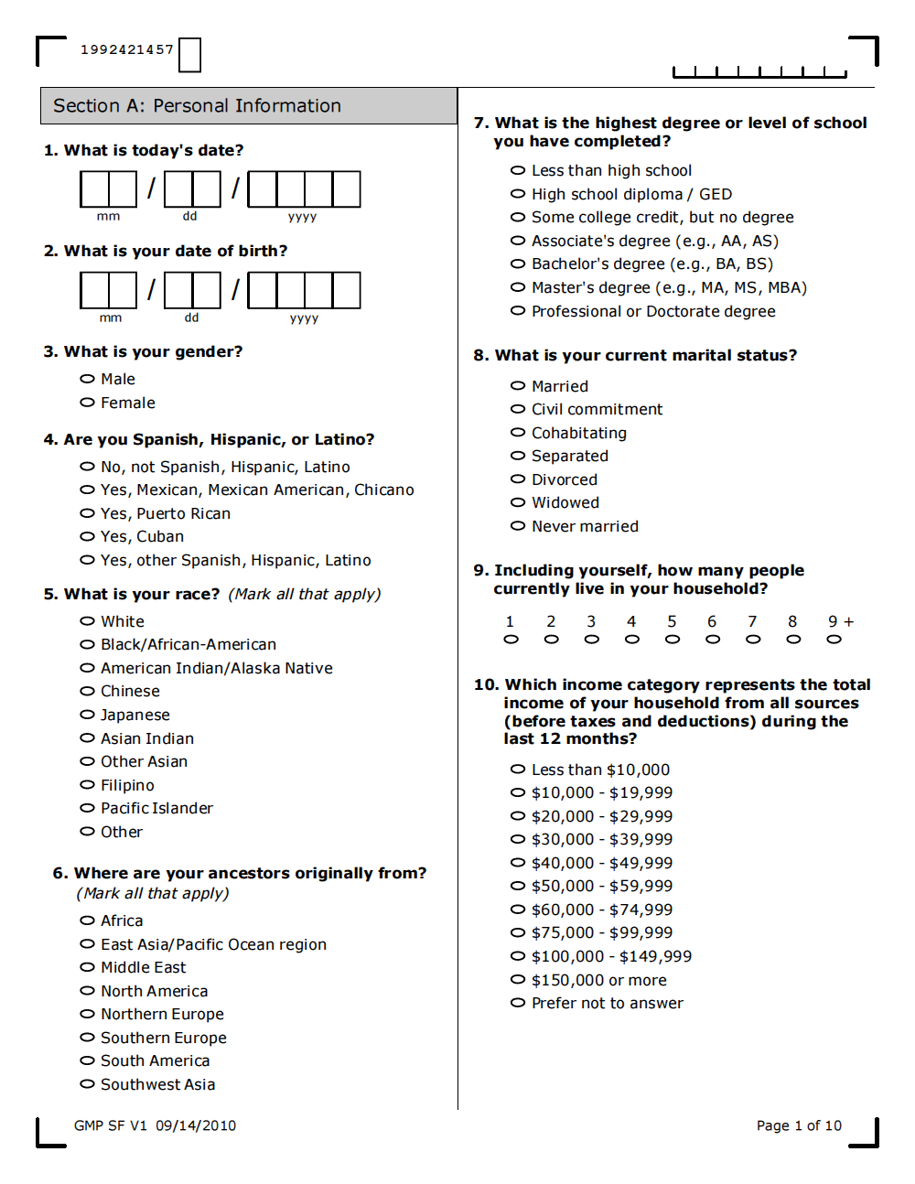
Baseline Survey
Collects basic demographic, health, and lifestyle information including:
  Health status
  Military experience
  Medical history
  Healthcare utilization
  Family pedigree
  Family history of disease
Notes:
Coordinate with upcoming VA appointment when possible

Slide 23
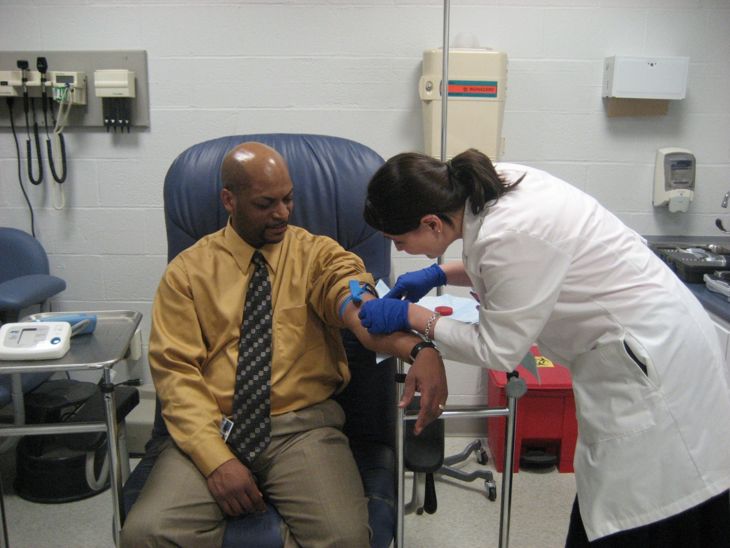
MVP Study Visit
Study visit procedures
  Obtain consent/HIPAA
  Collect blood specimen
  Walk-ins given printed baseline form
  Given MVP pin
All aspects are automated using SharePoint and GenISIS.

Slide 24
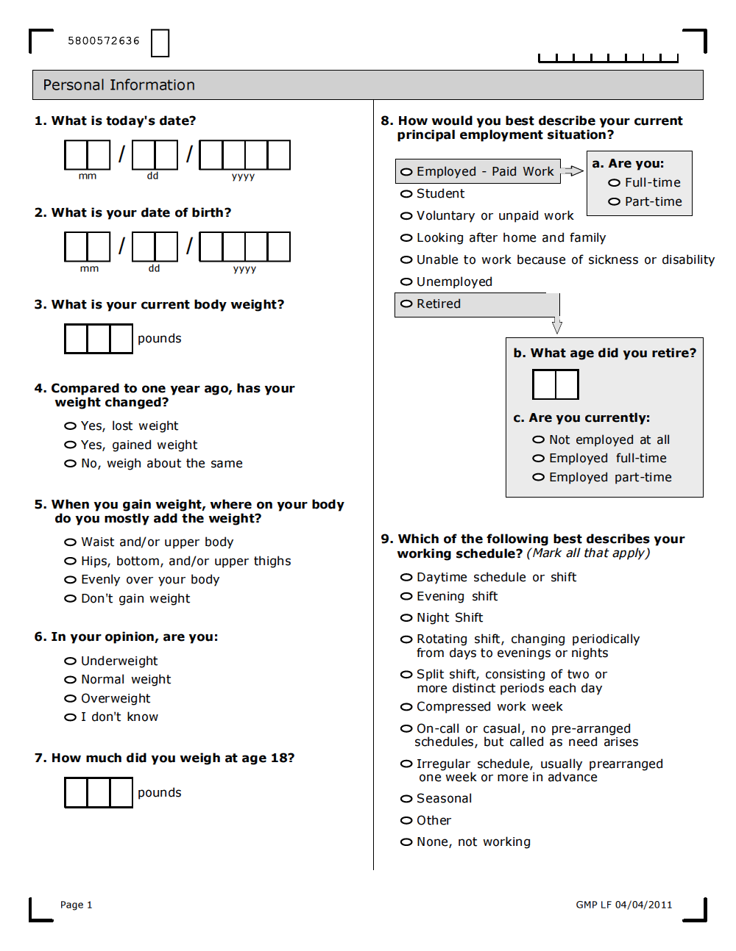
Thank You / Lifestyle Survey
Thank you letter
Lifestyle Survey
  Occupational history
  Combat history
  Exercise habits
  Mental health
  Environmental exposures
  Dietary habits
Notes:
Topics such as

Slide 25

MVP Enrollment Sites
Seattle
New England Consortium
White River Junction, VT
Northampton, MA
Bedford, MA
Manchester, NH
Togus, ME
Portland
Minneapolis
Boston: 5,517
Madison
Buffalo
Albany
Milwaukee
Northport
West Haven: 6,513
Iowa City
Manhattan
Hines
Cleveland
Pittsburgh
Philadelphia
Salt Lake City
Baltimore: 2,858
Palo Alto
Indianapolis
Washington DC
Denver: 4,202
Louisville
Kansas City: 3,390
Cincinnati
Richmond
Leavenworth
St. Louis
Hampton
Los Angeles
Loma Linda
Nashville
Durham
Memphis
Salisbury
Long Beach
Phoenix
Albuquerque
San Diego
Little Rock
Columbia
Birmingham
Charleston
Tucson
Tuscaloosa: 4,003
Atlanta
Dallas
Shreveport
Temple
Houston
Gainesville
Open at a total of 60 sites
Wave rollout
Active facilities
  55 main sites
  60 satellite facilities
5 sites launching in 2017
San Antonio
Tampa
Orlando
Bay Pines
Miami
= Actively Recruiting
San Juan: 193
= Closed to Recruitment

Slide 26
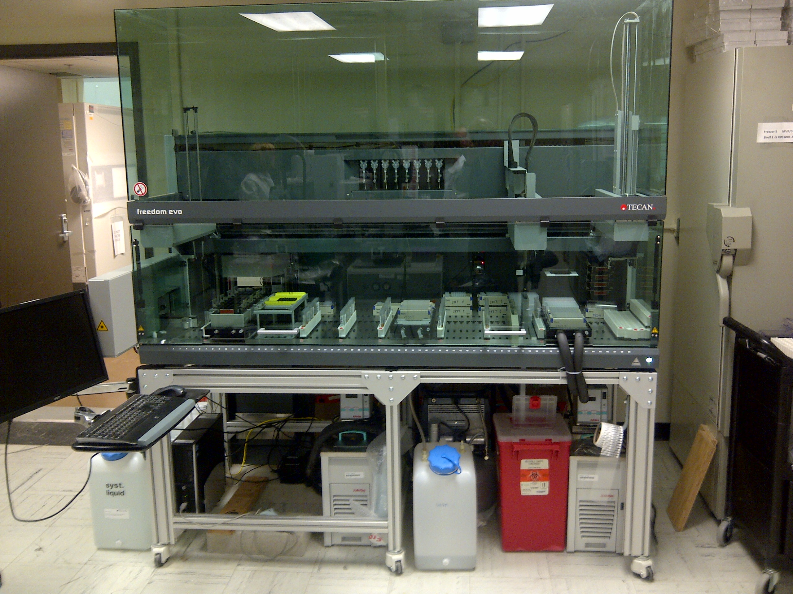
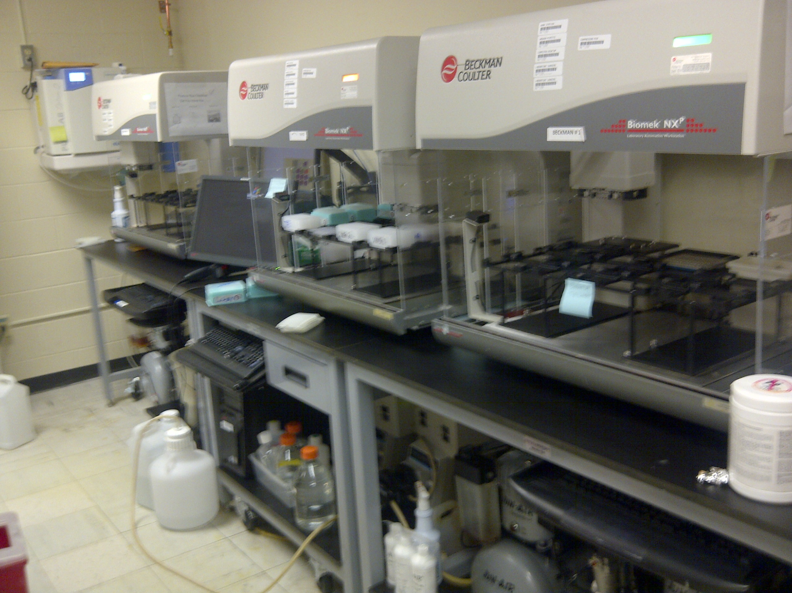

Slide 27
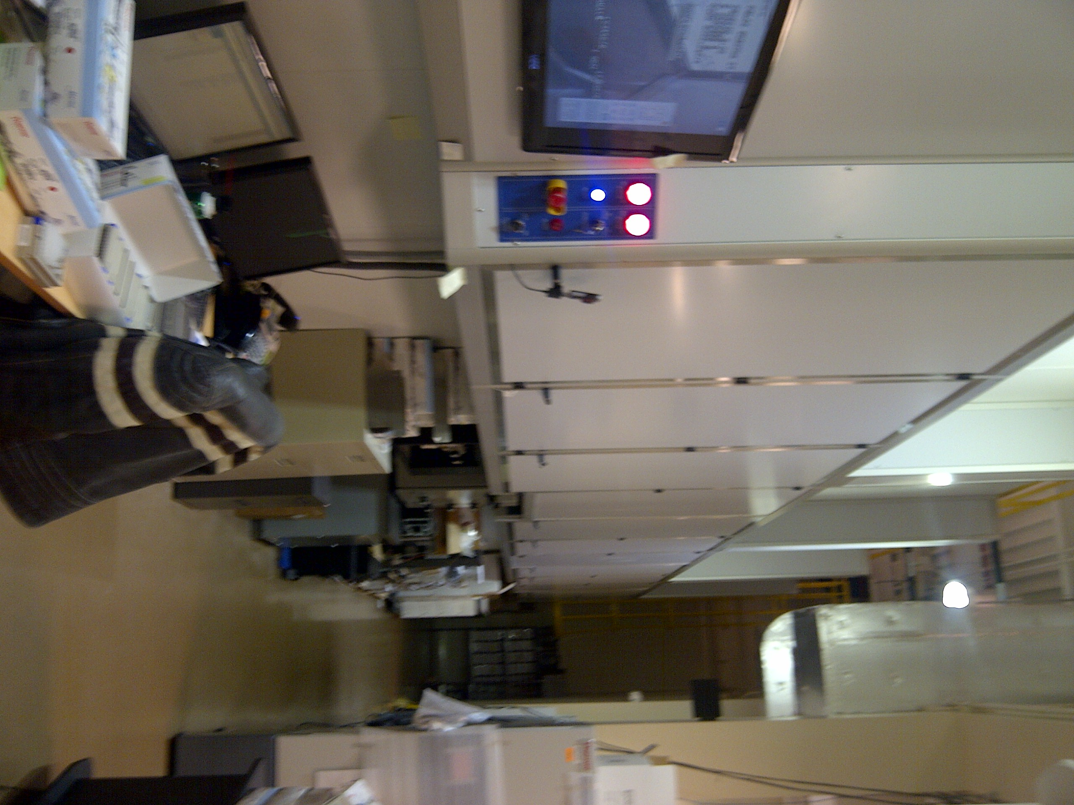
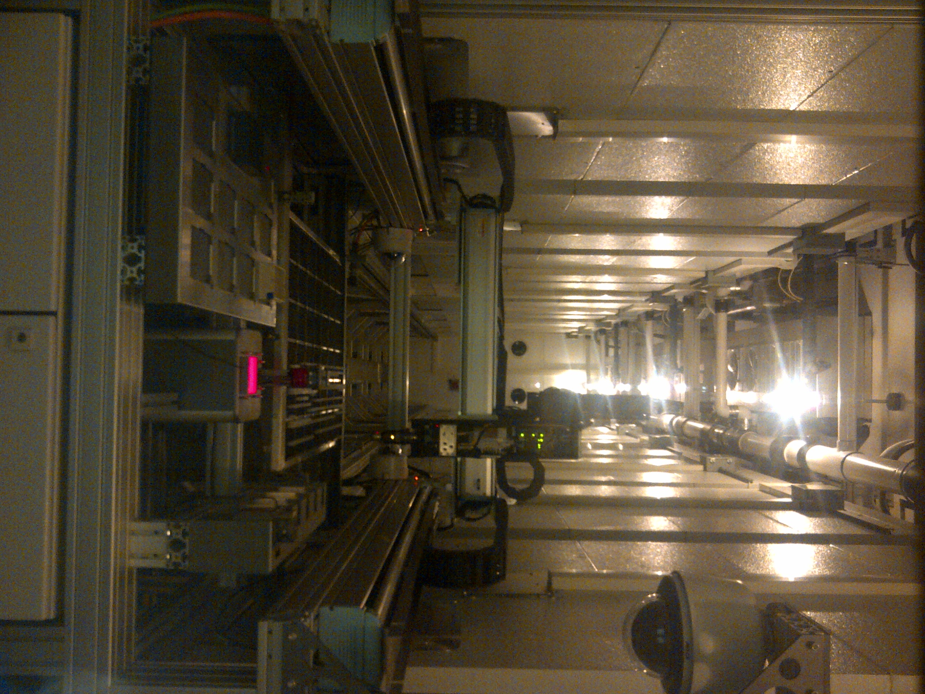
VA Central Biorepository

Slide 28
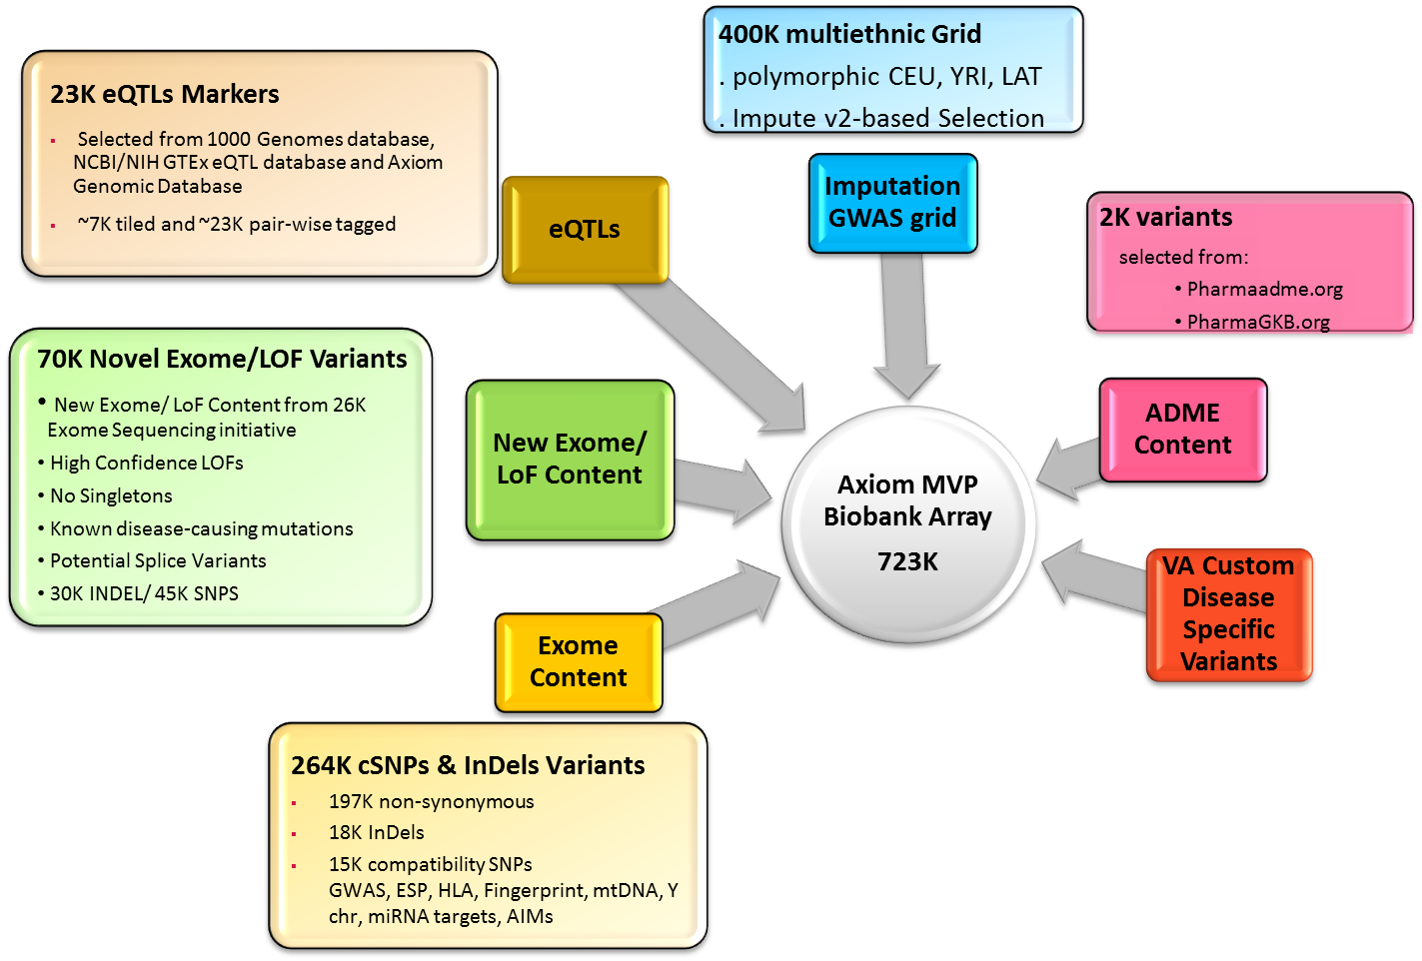
Axiom MVP Biobank Array

Slide 29
MVP as a Use Case for Big Data: Milestones
Invitation mailings sent | Over 4 Million
Consented Veterans | 560,000
Completed Baseline Surveys | 600,000
Genotyped, Sequenced | 500,000, 2000 WGS, 20,000 WES
Scientific working groups | 8
Funded Science | 3 alpha and 5 beta test projects
Scientist, analysts | 80
Abstracts presented | 7
Abstracts in prepraration | 30

Slide 30
Ongoing Scientific Projects
Type of Project | Topic | VA & University Affiliations
Alpha test | Schizophrenia and Bipolar Disorder (CSP 572) | Miami, Bronx, West Haven and Boston VAs; University of Miami; Mt. Sinai School of Medicine; Yale; Harvard; Stanford
Alpha test | PTSD in Veterans (CSP 575B) | San Diego, West haven and Boston VAs; UC San Diego; Yale
Alpha test | Gulf War Illness (CSP 2006) | Durham, West Haven and Boston VAs; Duke, Yale
Beta test | Cardiovascular Disease | Atlanta and Boston VAs; Emory; Harvard; Boston University
Beta test | Chronic Kidney Disease | Nashville and Memphis VAs; Vanderbilt; University of Tennessee Health Science Center
Beta test | Cardio-metabolic Disease | Palo Alto, Philadelphia, Albany, Boston and Phoenix VAs; University of Pennsylvania; Stanford; Albany Medical College; University of Massachusetts; Harvard; Arizona State University
Beta test | Multi-substance Abuse Disorders | West Haven & Philadelphia VAs; Yale; University of Pennsylvania
Beta test | Age-related Macular degeneration | Cleveland VA; Case Western Reserve

Slide 31
Five-Year Plan for Expanding Data Access
FY2018-2020
Phase 3:
Up to 1M genotypes
Whole genomes on targeted phenotypes – up to 10,000 WGS
Up to 200 simultaneous users by FY18
Up to 1000 simultaneous users by FY20
FY2017
Phase 2:
500k genotypes
50-75 simultaneous users
Pilot consortia with DOE, DoD and NIH researchers
New VA RFI for next round of projects
FY2016
Phase 1:
α- and β-tests (8 total projects)
400k genotypes
EHR data
survey data
25 simultaneous users:
VA and academic affiliates

Slide 32
MVP Data Universe
Biospecimen
Self-reported
MVP surveys
MVP
Participant
Molecular
Data
VA - Clinical
VINCI,
CDW/NDS
Non-VA
NDI, CMS

Slide 33

VA Analytic Ecosystem (2015)
Common Data ♦ Common Infrastructure ♦ Common Tools ♦ Common Security
Governance Board
The EHR data available in the CDW and other data sources is among the best in the world.
Strategy
Policy
Priorities
Requirements
REGION 1
REGION 2
REGION 3
REGION 4
Vx
Vx
Vx
Vx
Vy
R2
R2
Vy
Vx
Vx
Vy
R1
R1
Vy
Vn
Vn
Vy
R4
R4
Vy
Vn
Vn
Vn
Vn
Patients: 22 M
Lab Results
7.7B
Clinical Orders
4.5B
Immunizations
71M
Appointments
1.4B
Vx
Vx
CDW
GP
BI
AN
RD
FR
Vy
R3
R3
Vy
CDW System Facts:
Source system:
  VISTA: 130
  Other Major Systems: 7
Data facts:
  Domains of information: 68
  Rows of data: 2+ Trillion
  Columns of data: 22,000+
  Tables of data: 840+
Active Users: 30,000/Month
Vibrant user community
Active governance process
Data quality program
Vn
Vn
Enterprise
Pharmacy Fills
2.2B
Clinical Notes
3.2B
Health Factors
2.2B
Encounters
2.4B
CDW Sample Data Facts:
Unique Veterans: 22 million
Outpatient encounters: 2.4 billion
Inpatient admissions: 17 million
Clinical orders: 4.5 billion
Lab tests: 7.7 billion
Pharmacy fills: 2.2 billion
Radiology procedures: 202 million
Vital signs: 3.3 billion
Text notes: 3.2 billion
CDW Analytic Enclaves:
GP: General Purpose
BI: Business Intelligence
AN: Analytics and Informatics
RD: Health Services R&D (VINCI)
FR – Field Reporting
Radiology Proc
202M
Vital Signs
3.3B
Consults
315M
Admissions
17M
CDW Analytic Capabilities:
Primary/Secondary/Data Mart Structures
Data Standardization
Metadata Services
Business Intelligence Reporting & Dashboards Tools
Geospatial Mapping Tools and Images
SAS/Grid High Performance Compute Grid
Natural Language Processing Engines
Hadoop Cluster
Surgeries
14M
Oncology
1.3M
Domains: 15/68

Slide 34

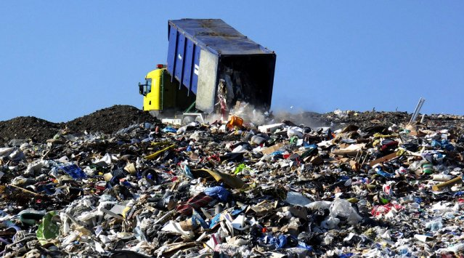
The Future: “Big Data”
More and more data is becoming available for health care research: is it a blessing or a curse?
Sometimes, data warehouses resemble landfills more than libraries
Apply the 4 C’s: collect, catalogue, clean and curate.
Notes:
Stockholm-Public-Library-Interior-2.jpg

Slide 35
Million Veteran Program: Data Sources
VA Data
Corporate Data Warehouse (CDW)
VA medical record data containing:
Diagnosis Codes ( ICD-9/ ICD-10)
Procedure Codes (CPT and ICD-9 Procedure)
Laboratory Tests
Medications
Health Factors
Notes (unstructured data)
MVP Consented Data
MVP Baseline and Lifestyle Surveys
Blood samples and results of processing
VA Registry Data
The Clinical Assessment, Reporting, and Tracking System for Cardiac Catheterization Laboratories (CART-CL): National VA reporting system, data repository, and quality improvement program for procedures performed in VA cardiac catheterization laboratories
VA Central Cancer Registry (VACCR): Cancer cases identified by VA tumor registrars
External Peer Review Program (EPRP): Abstractions from chart reviewers performing quality improvement reviews
VA Suicide Prevention Application Network (SPAN): Suicide attempt data
Veterans Affairs Surgical Quality Improvement Program (VASQIP): Surgical data
Non-VA Data
DoD (Department of Defense)
VA DoD Identity Repository (VADIR) & Beneficiary Identification and Records Locator Subsystem (BIRLS): Military service history
Military Entrance Processing Command (MEPCOM): Enrollment physicals
Operation Enduring Freedom/ Operation Iraqi Freedom/ Operation New Dawn Roster (OEF/OIF/OND Roster): Identifies Veterans who have been involved in the OEF/OIF/OND mission
Centers for Medicare and Medicaid (CMS)
- Diagnosis codes (ICD-9/ICD-10), procedures, medications and enrollment data for veterans enrolled in Medicare or Medicaid
Potential Data Sources
Environmental exposures, wearables and other data linkage
NDI (National Death Index) via Centers for Disease Control (CDC)
- Date and cause of death including record-axis codes

Slide 36
VA Data Sources
Corporate Data Warehouse Databases
National Patient Care Databases
Vital Status
Decision Support System
National Data Extract
Beneficiary Identification Records Locator (BIRLS) death file
New England VISN-1 Pharmacy files
Outpatient Clinic File (OPC)
Patient Treatment File (PTF)
Inpatient and Outpatient Hospitalizations
Clinic Inpatient and Outpatient Visits
Diagnosis (ICD-9) codes
Procedure (CPT) codes
Pharmacy data and laboratory data
Pharmacy Benefit Management (PBM) system database
OEF/OIF and OND Roster
VA Clinical Assessment Reporting and Tracking (CART)
Veterans Affairs Surgical Quality Improvement Program (VASQIP)
Veterans Affairs Central Cancer Registry (VACCR)
National Data Systems (NDS)
Special Data Access w/ Data Steward

Slide 37
System Architecture
Data
Warehouse
Study Mart
Vendor
Survey Data
Honest
Broker
Study Mart
Analysis
Environment
VA
Clinical Data
Study Mart
Non VA
NDI, CMS
Consent Manager
Molecular Lab
Molecular data
Query
Mart
Query Portal
Access Authorization by Governance System
Researcher

Slide 38
Our Vision for Phenotyping in MVP:
A New Aproach
Manual
Semi-automated
Automated
Semi-automated phenotyping combines features of manual and automated phenotype development

Slide 39
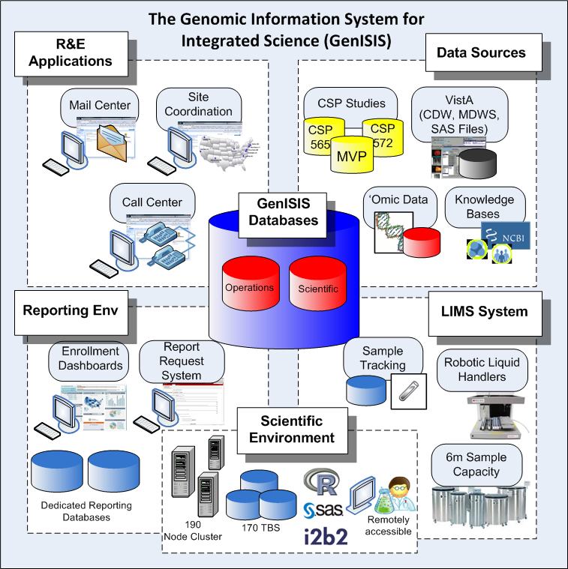

Slide 40
VA Big Data Partnerships
Federal partners
  DOE
  DOD
  NIH
Other Federal
  FDA, CDC
ORD
  BLRD
  CSRD, CSP, MVP/GenISIS
  HSRD, QUERI, VIREC
  RRD
Other VA partners
  OIT
  VHA
    Clinical analytics
    Specialty Services
    Shared care
  Leadership
NonFederal partners
  Academic (Harvard, Stanford, Yale, Broad, etc.)
  Foundations (AHA, PCF, etc.)
  Other Biobanks (UKBio, Kaiser, etc.)
  Industry

Slide 41
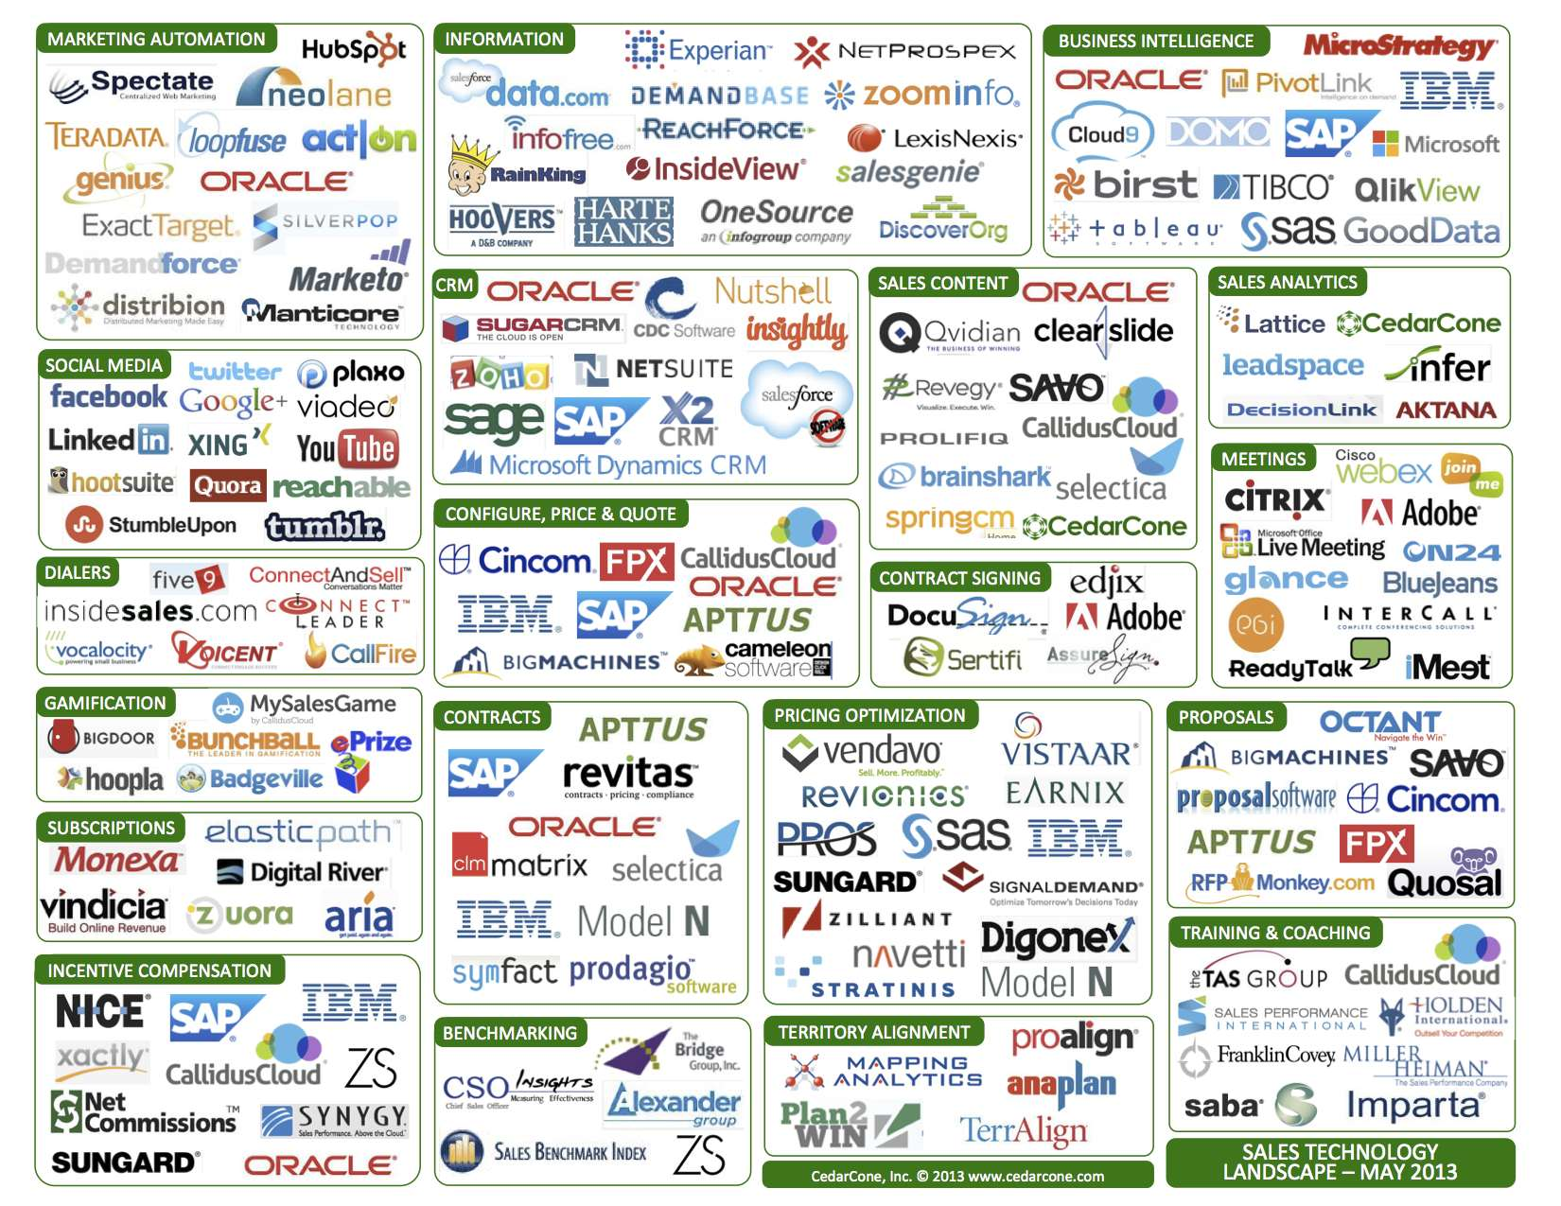

Slide 42

Core Components & Competencies
Knowledge and skill in Clinical Content, Epidemiology, Genetics, and Medical Informatics . The VA team has deep knowledge and skill in epidemiology, genetics, medical informatics, analytics, and medical domain knowledge..
Peta Scale High Performance Computing Environment, required to process the large scale data for predictive models and simulations.
Knowledge and skill in Peta Scale Data Management, required to manage the petabyte scale data to feed predictive models and simulations.
Phenotype data, or physical traits data, is created through the Electronic Health Record (EHR) process and centrally stored in the Corporate Data Warehouse (CDW). This collection of data, is massive in data volume.
Knowledge and skill in Computation Sciences. The DOE team has deep knowledge and skill in the computational sciences and creating predictive and simulation models at peta scale.
Genotype data, or genetic composition data, is created through the MVP blood sample process. This collection of data is massive in data size.

Slide 43
“Big Data” Vision
Data partners contribute data and expertise.
NIH
National Healthcare User Facility
(a.k.a CERN for Healthcare)
NDI
Commercial Environment
Infrastructure as a Service
  Data Storage
  Disaster Recovery
Platform as a Service
  Model Processing
Software as a Service
  Commercial Models
Commercial
Cloud
(Azure, AWS)
DoE
(ORNL, ANL, ETC.)
DoD
CMS
VA Computing Envvironment
Data assimilation, aggregation & storage
Data exploration & visualization
Data curation
Self-service tools
Automated study mart development
Minimal COTS tools
VA
DOE Secure PHI enclave
Heterogenous data: Phenotype, Genotype, Images
Genetic data pipeline (e.g. Broad pipeline)
Open Source Lab w/ Synthetic Data
Advanced Computing Environment
Data Store R&D
Phenotype Registry
Heterogenous Data Study Marts
Model Building & Refinement
“Data Science” Academy (Seminars, Conferences, Hackathons)

Slide 44
Baseline Infrastructure at ORNL
(and future VA Supercomputers@ORNL)
Hosted VMs – Windows and Ubuntu
(Private Cloud)
R, Python, Java
Jupyter
Spark + YARN/HDFS
Hail
(Postgres)
Murphy
Deep Learning Supercomputer
(NVIDIA DGX-1)
(Grace)
Hopper
CDW
(Daniel)
Daly
DDN:
(GPFS)
CDW Data
CDW text notes
Vista Images
Surveys
CDC
CMS
DoD
Backups and Archive
Monitoring and Management

Slide 45
Draft Research Approval Process

Slide 47
MVP CHAMPION Joint Governance Committee:
Proposed Structure
Cancer
Moonshot
National Strategic
Computing Initiative
Open Government
Initiative
Precision Medicine
Initiative (PMI)
Big Data R&D
Initiative
Related
National Initiatives
Liaison
MVP CHAMPION Program
Secretary
VA
Statement of
Principles / IAA
Secretary
DOE
VA
Chief R&D Officer (CRADO)
Executive
Sponsors
DOE
Director NNSA & Office of Science
VA Big DATA Programs
MVP
GenISIS
VA CDW
VIINCI
VA Next Gen IT
Platforms at Scale
MVP CHAMPION
Joint Governance Committee
VA/DOE Committee Co-Chairs
VA/DOE/Nat Lab Senior Leaders
Ex-Officio Members
Advisory Members
Admin. Support Staff
DOE / National Lab Capabilities
10 gigabyte Network Connection between
VA Austin/Pittsburgh and ORNL
Exascale Computing platform on ORNL
CADES platform; Hosted in a PHI secure
enclave
Storage for 2-3 petabytes for Genomics
data and VA CDW
Standing
Committees
Ad Hoc Working
Groups

Slide 48
Pragmatic Trial of HCTZ v. Chlorthalidone at the Point of Care
Care providers using EMR
Cohort
Identification Centrally
Phone
Enrollment
& Consent
Intervention
Delivered
by mail
Randomize
Data Capture
By EHR &CMS
Clinical
Decision Support
Study DB
Analysis
Study team using traditional scientific tools

Slide 49
A CERN for Healthcare

Slide 50
Acknowledgments
MVP Local Site Investigators
VA HEALTHCARE SYSTEM UPSTATE NEW YORK: Laurence Kaminsky, Ph.D. NEW MEXICO VA HEALTHCARE SYSTEM: Jose Canive, M.D. ATLANTA VA MEDICAL CENTER: Farooq Amin, M.D. VA MARYLAND HEALTH CARE SYSTEM: Alan Shuldiner, M.D.; Miriam Smyth, Ph.D. BAY PINES VA HEALTHCARE SYSTEM: Rachel McArdle, Ph.D.; Theodore Strickland, M.D., M.P.H., F.C.A.P. EDITH NOURSE ROGERS MEMORIAL VETERANS HOSPITAL: John Wells, Ph.D. BIRMINGHAM VA MEDICAL CENTER: Louis Dell'Italia, M.D.; Jasvinder Singh, M.D., M.P.H. VA BOSTON HEALTHCARE SYSTEM: Ildiko Halasz, M.D. VA WESTERN NEW YORK HEALTHCARE SYSTEM: Junzhe Xu, M.D.; Ali A. El Solh, M.D., M.P.H. CENTRAL TEXAS VETERANS HEALTH CARE SYSTEM: Keith Young, Ph.D. RALPH H. JOHNSON VA MEDICAL CENTER: Mark Hamner, M.D. CINCINNATI VA MEDICAL CENTER: John B. Harley, M.D., Ph.D. LOUIS STOKES CLEVELAND VA MEDICAL CENTER: Eric Konicki, M.D.; Curtis Donskey, M.D. WM. JENNINGS BRYAN DORN VA MEDICAL CENTER: Kathlyn Sue Haddock, R.N., Ph.D. VA NORTH TEXAS HEALTH CARE SYSTEM: Padmashri Rastogi, M.D. VA EASTERN COLORADO HEALTH CARE SYSTEM: Robert Keith, M.D. DURHAM VA MEDICAL CENTER: William Yancy, M.D. N. FL/S. GA VETERANS HEALTH SYSTEM: Peruvemba Sriram, M.D. HAMPTON VA MEDICAL CENTER: Marinell Mumford, Ph.D.; Pran Iruvanti, D.O., Ph.D. EDWARD HINES, JR. VA HOSPITAL: Salvador Gutierrez, M.D. MICHAEL E. DEBAKEY VA MEDICAL CENTER: Rayan Al Jurdi, M.D.; Laura Marsh, M.D. RICHARD ROUDEBUSH VA MEDICAL CENTER: John Callaghan, M.D., Ph.D.; Thomas Sharp, M.D. KANSAS CITY VA MEDICAL CENTER: Prashant Pandya, D.O.; Thomas Demark, M.D. VA EASTERN KANSAS HEALTH CARE SYSTEM: Mary Oehlert, Ph.D. CENTRAL ARKANSAS VETERANS HEALTH CARE SYSTEM: K. David Straub, M.D., Ph.D.; Sue Theus, Ph.D. VA LOMA LINDA HEALTHCARE SYSTEM: Ronald Fernando, M.D. VA LONG BEACH HEALTHCARE SYSTEM: Timothy Morgan, M.D. VA GREATER LOS ANGELES HEALTH CARE SYSTEM: Agnes Wallbom, M.D., M.S. WILLIAM S. MIDDLETON MEMORIAL VETERANS HOSPITAL: Robert Striker, M.D., Ph.D. VA MAINE HEALTHCARE SYSTEM: Ray Lash, M.D., F.A.C.P. VA MEDICAL CENTER MANCHESTER: Nora Ratcliffe, M.D. VA NEW YORK HARBOR HEALTHCARE SYSTEM: Scott Sherman, M.D., M.P.H. MEMPHIS VA MEDICAL CENTER: Richard Childress, M.D.; Marshall Elam, M.D., Ph.D. MIAMI VA HEALTH CARE SYSTEM: Hermes Florez, M.D., Ph.D. CLEMENT J. ZABLOCKI VA MEDICAL CENTER: Jeff Whittle, M.D., M.P.H. MINNEAPOLIS VA HEALTH CARE SYSTEM: Frank A. Lederle, M.D. VA TENNESSEE VALLEY HEALTHCARE SYSTEM: Adriana Hung, M.D., M.P.H.; Jeffrey Smith, M.D., Ph.D. CENTRAL WESTERN MASSACHUSETTS HEALTHCARE SYSTEM: Kristin Mattocks, Ph.D., M.P.H. ORLANDO VA MEDICAL CENTER: Kenneth Goldberg, M.D.; Adam Golden, M.D. VA PALO ALTO HEALTH CARE SYSTEM: Philip Tsao, Ph.D. PHILADELPHIA VA MEDICAL CENTER: Darshana Jhala, M.D.; Kyong-Mi Chang, M.D. PHOENIX VA HEALTH CARE SYSTEM: Samuel Aguayo, M.D. VA PITTSBURGH HEALTH CARE SYSTEM: Elif Sonel, M.D.; Gretchen Haas, Ph.D. PORTLAND VA MEDICAL CENTER: David Cohen, M.D. RICHMOND VA MEDICAL CENTER: Michael Godschalk, M.D. W.G. (BILL) HEFNER VA MEDICAL CENTER: Robin Hurley, M.D. VA SALT LAKE CITY HEALTH CARE SYSTEM: Laurence Meyer, M.D., Ph.D.; Vickie Venne, M.S. SOUTH TEXAS VETERANS HEALTH CARE SYSTEM: Sunil Ahuja, M.D.; Jacqueline Pugh, M.D. VA SAN DIEGO HEALTHCARE SYSTEM: Gwen Anderson, Ph.D., R.N. VA CARIBBEAN HEALTHCARE SYSTEM: Carlos Rosado-Rodriguez, M.D.; William Rodriguez, M.D. VA PUGET SOUND HEALTH CARE SYSTEM: Edward Boyko, M.D.; Karin Nelson, M.D. OVERTON BROOKS VA MEDICAL CENTER: Ronald Washburn, M.D. ST. LOUIS VA HEALTH CARE SYSTEM: Michael Rauchman, M.D. JAMES A. HALEY VETERANS’ HOSPITAL: Stephen Mastorides, M.D.; Lauren Deland, R.N., M.P.H. SOUTHERN ARIZONA VA HEALTH CARE SYSTEM: Ronald Schifman, M.D.; Stephen Thomson, M.D. TUSCALOOSA VA MEDICAL CENTER: Lori Davis, M.D.; Patricia Pilkinton, M.D. WASHINGTON DC VA MEDICAL CENTER: Ayman Fanous, M.D. VA CONNECTICUT HEALTH CARE SYSTEM: Daniel Federman, M.D. WHITE RIVER JUNCTION VA MEDICAL CENTER: Brooks Robey, M.D.
VA Central Office
Timothy O’Leary, M.D., Ph.D.; Sumitra Muralidhar, Ph.D.; Ronald Przygodzki, Ph.D.; Grant Huang, Ph.D., M.P.H.; James Breeling, M.D.; Jennifer Moser, Ph.D., Kendra Schaa, Kristina Hill
MVP Steering Committee and Subcommittees
Steering Committee: John Concato, M.D., M.S., M.P.H., Co-Chair; J. Michael Gaziano, M.D., M.P.H., Co-Chair; Rayan Al Jurdi, M.D.; James L. Breeling, M.D.; Louis Fiore, M.D., M.P.H., ex-officio; John B. Harley, M.D., Ph.D.; Elizabeth Hauser, Ph.D.; Grant Huang, M.P.H., Ph.D. Ex-Officio; Phil Tsao, Ph.D.; Janet D. Crow, ORD Liaison; Philip D. Harvey, Ph.D.; Timothy J. O’Leary, M.D., Ph.D., Ex-Officio; Stephen G. Waxman, M.D., Ph.D.; Peter W. F. Wilson, M.D.
Access Policy Subcommittee: John, Concato, M.D., M.S., M.P.H., (Chair); Sumitra Muralidhar, Ph.D. (VACO Liaison); Michael Hart, M.D.; Fred Wright, M.D.; John (Tom) Callaghan M.D., Ph.D.; J. Michael Gaziano, M.D., M.P.H.; Saiju Pyarajan, Ph.D. ; Carl Grunfeld, M.D., Ph.D.
Chemical Analysis Subcommittee: Philip Tsao, Ph.D. (Chair); Steven Schichman, M.D., Ph.D.; Saiju Pyarajan, Ph.D.; Chris Corless, M.D., Ph.D.; Robert Lundsten; Jenny Moser, Ph.D.; Sunil Ahuja, M.D.
Recruitment Subcommittee: Rayan Al Jurdi, M.D. (Chair); Jennifer Deen, Hermes Florez, M.D., Ph.D., M.P.H.; Amy Kilbourne, Ph.D., M.P.H.; Frank Lederle, M.D.; Kendra Schaa, ScM, C.G.C. (ORD Liaison); Ralph Heussner; Stephen Herring.
Phenotyping and Epidemiology Subcommittee: J. Michael Gaziano, M.D., M.P.H. (Chair); Jenny Moser, Ph.D.; Seth Eisen, M.D., M.Sc.; David Gagnon, M.D., Ph.D.; Saiju Pyarajan, Ph.D.; Jonathan Nebeker, M.D., M.S.; Denise Hynes, Ph.D., M.P.H., R.N.; Matthew Samore, M.D.
Boston Coordinating Center (MAVERIC)
J. Michael Gaziano, M.D., M.P.H.; Stacey Whitbourne, Ph.D., Jennifer Deen; Colleen Shannon, M.P.H.; Kelly Cho, Ph.D.; Xuan-Mai Nguyen, Ph.D.; David Gagnon, M.D., Ph.D.; Donald Pratt; Lindsay Hansen, M.P.A.; Keri Hannagan, M.P.H.; Derrick Morin
West Haven Coordinating Center (CERC)
John Concato, M.D., M.P.H.; Mihaela Aslan, Ph.D.; Peter Guarino, Ph.D.; Daniel Anderson; Rene LaFleur; Lesley Mancini, M.B.A.; John Russo; Cindy Cushing; Vales Jean-Paul; Fred Sayward; Louis Piscitelli; Donna Cavaliere
VA Central Biorepository - Boston
Mary Brophy, M.D., M.P.H.; Donald Humphries, Ph.D.; Robert Lundsten; Geetha Sugumaran, Ph.D.; Deborah Govan; Christine Govan
Genomic Information System for Integrated Sciences (GenISIS) - Boston
Louis Fiore, M.D., M.P.H.; Saiju Pyarajan, Ph.D.; John Gargas; Tony Chen, Ph.D.; Edmund Peirce; Paul Hseih, Ph.D.; Luis Selva, Ph.D.; Beth Katcher; Robert Hall, M.P.H.; Weijia Mo; Felicia Fitzmeyer; Anahit Aleksanyan
MVP Information Center – Canandaigua, NY
Annie Correa; Melissa Juhl; George Barzac III; Liam Cerveney; Anne Van Patten; Jonathan Martinez; Eileen Loh-Fontier; Jessica Marino

Slide 51
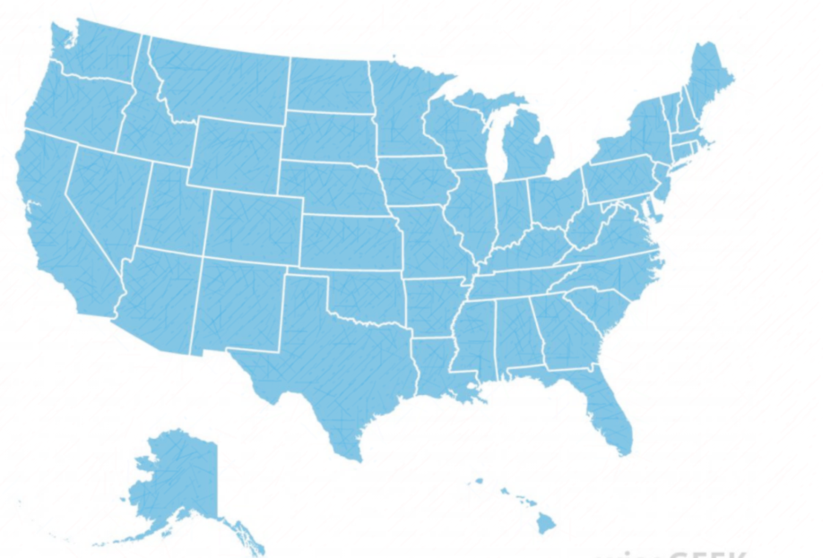
Large-Scale Biobanks
  United States
  MVP
  PMI CP
  Kaiser
  Geisinger
  BioVU
  Marshfield Clinic
  American Cancer Society
  Academic Medical Centers: Howard University African Diaspora, Mayo Clinic, Partners Healthcare, Chicago area consortium, etc.
  Health system consortia: eMERGE
  Large scale cohorts in corsortia: CHARGE, NCI Cancer Cohort Consortium
International
Kadoorie (China)
Mexico City
Gambian National DNA Bank (Africa)
H3 Africa
KHCCBIO (Jordan)
Europe
UK Biobank
Icelandic Biobank
Banco Nacional de ADN
GenomEUtwin
Finnish biobank
Swedish biobank
German biobank, KORA
UK DNA Banking Network & British biobank
Estonian biobank
Generation Scotland
HUNT (cardiovascular) & Biohealth
EPIC, European (cancer)
Danubian Biobank Consortium
GATiB Genome Austria Tissue Bank
Biobank Hungary

Slide 52
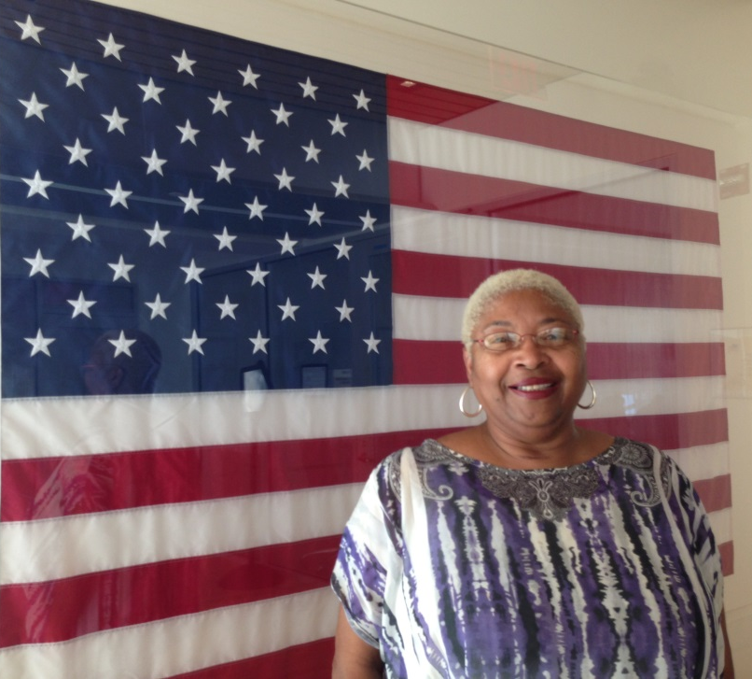
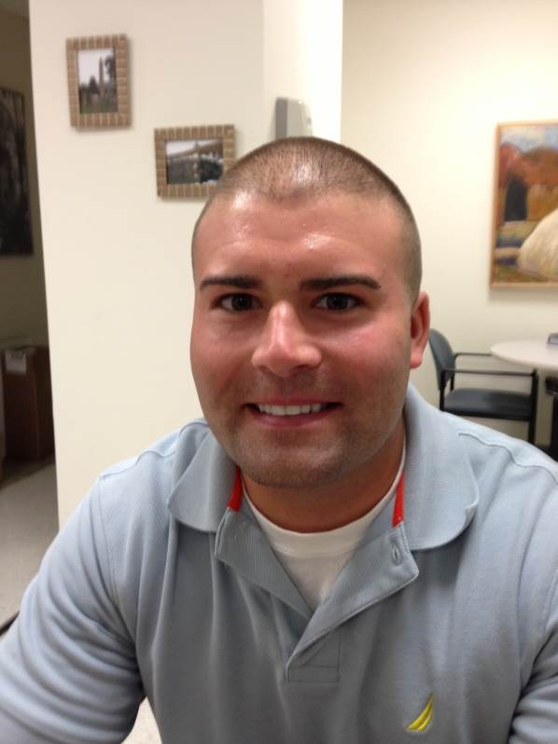
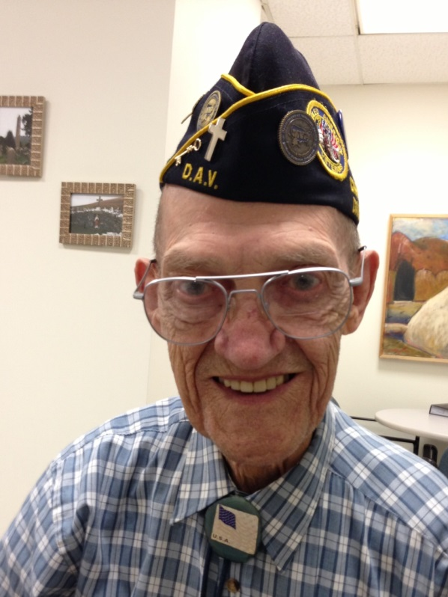
“I have always known someone in the family with Diabetes or Hypertension. I eagerly volunteered to participate in MVP so I can help medical researchers better understand how genes influence diseases. One blood draw is all it took… yet the potential to contribute to scientific discoveries is enormous!”
Priscilla Bryant, U.S. Army, 1974 - 1994
VA Palo Alto Health Care System
Why are Veterans Supporting MVP?
“Knowing that I would be helping other GI’s is the reason I am part of the Million Veteran Program.”
Mons S. Sjaastad, U.S. Army, Korean War Era
VA Connecticut Healthcare System
“I enrolled in The MVP because I thought it would help Veterans get even better healthcare in the future.”
Gennaro F. Carbone, U.S. Marine Corps, Gulf War Era
VA Connecticut Healthcare System

Slide 53






Slide 54
Thank You
Discussion

Slide 55
Work Planned to Begin Joint VA-DOE Science by Oct-Nov 2017

